Slide 1
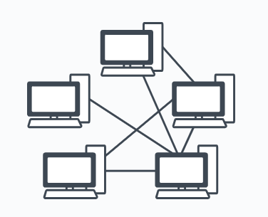

NETWORK METROLOGY 23-24
Presented by: Natesh Kumar (667574)
n.kumar3@studenti.unipi.it

Slide 2
This Presentation Covers:
PROJECT-3 OVERVIEW
PROJECT TOPOLOGY
MININET TOPOLOGY
SWITCH CONFIGURATION USING TRUNK
PROJECT CODE AND OUTPUT
PING OF SAME VLANS
WIRESHARK STATS
IPERF STATS
Topology with 5 switches on the ONOS web-GUI
Conclusion

Slide 3
PROJECT-3 OVERVIEW
Implement with namespaces and Open vSwitch.
Create two VLANs.
Using Mininet:
Implement a similar network with an arbitrary number of switches (I choose 5 Switches).
Enable ping only among hosts in same VLAN.
Report ping and iperf measurements.
Topology with 5 switches on the ONOS web-GUI.

Slide 4
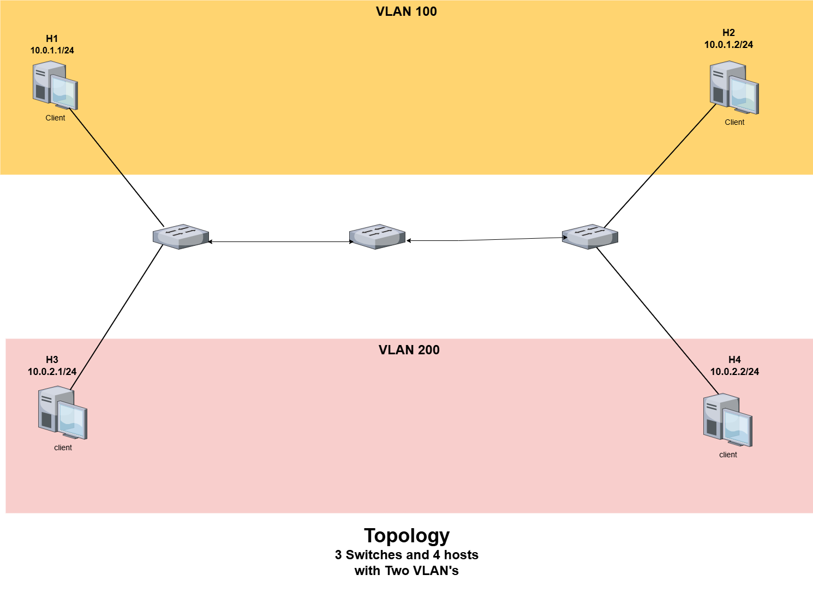
PROJECT TOPOLOGY

Slide 5
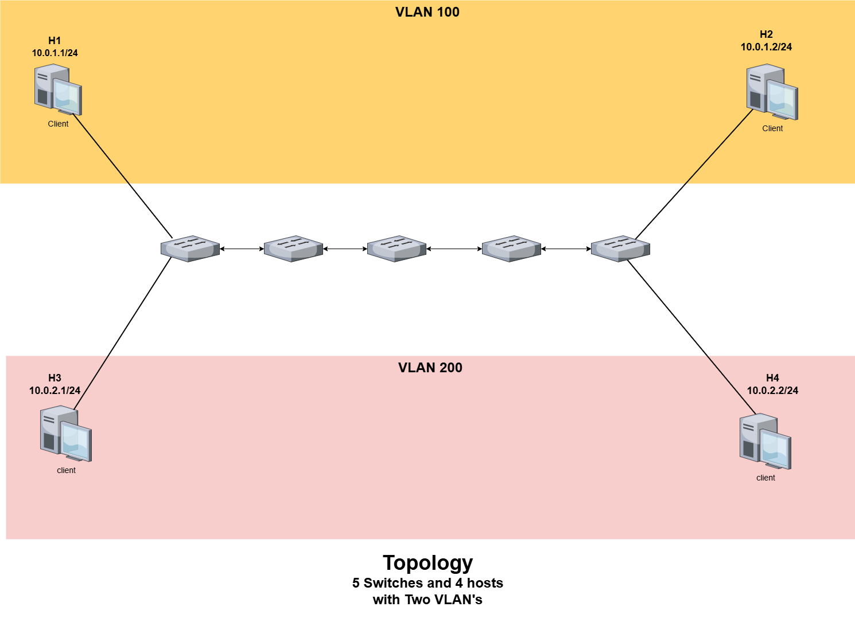
MININET TOPOLOGY

Slide 6
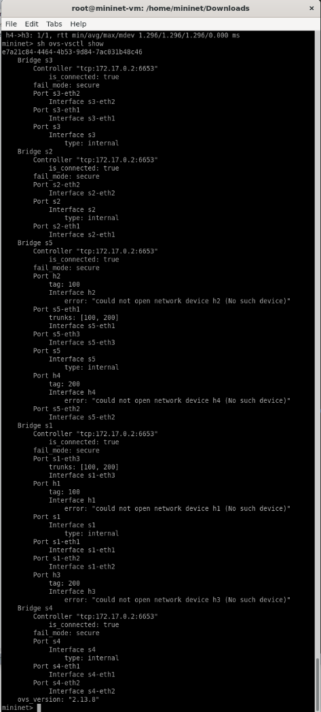
SWITCH CONFIGURATION USING TRUNK
"ovs-vsctl add-port s1 h1 -- set port h1 tag=100"
"ovs-vsctl add-port s1 h3 -- set port h3 tag=200"
"ovs-vsctl set port s1-eth3 trunks=100,200" #trunk to s2
"ovs-vsctl add-port s5 h2 -- set port h2 tag=100"
"ovs-vsctl add-port s5 h4 -- set port h4 tag=200"
"ovs-vsctl set port s5-eth1 trunks=100,200" #trunk to s4

Slide 7
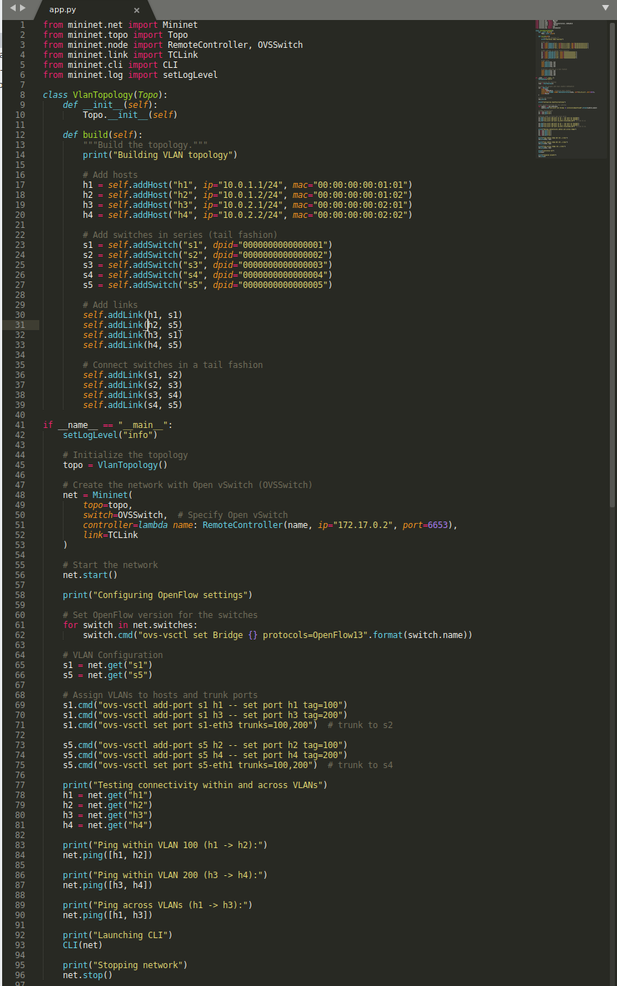
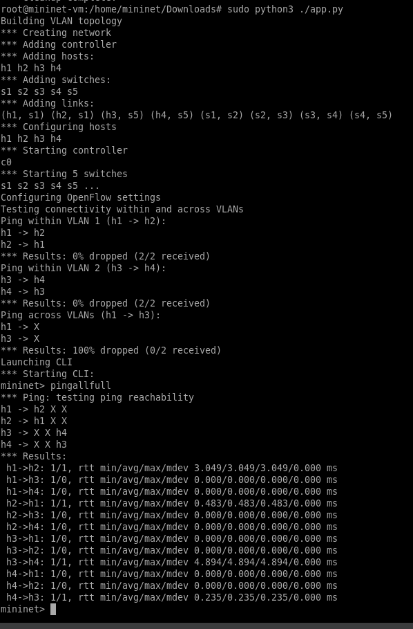
PROJECT CODE AND OUTPUT

Slide 8
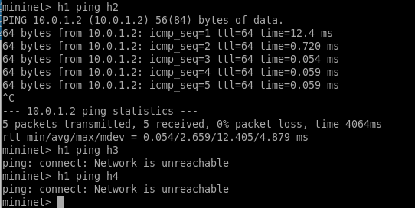
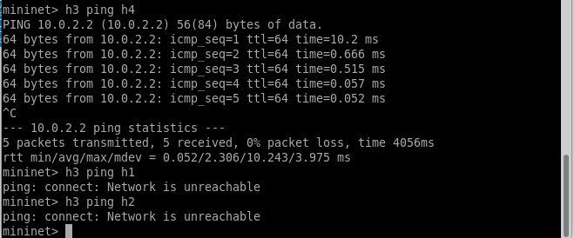
PING OF SAME VLANS
h1 can ping h2 with same (VLAN 100).
h2 can ping h4 with same (VLAN 200).

Slide 9
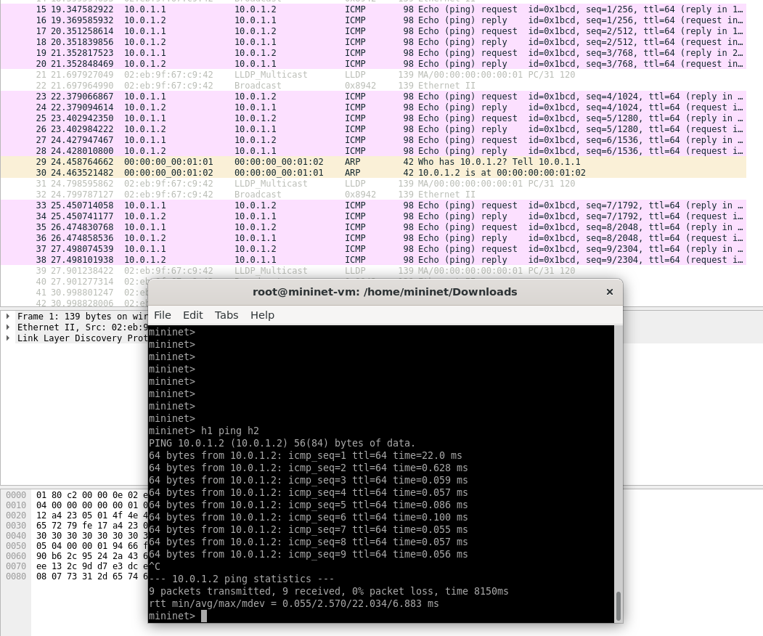
WIRESHARK STATS (h1 ping h2 in Switch 1)

Slide 10
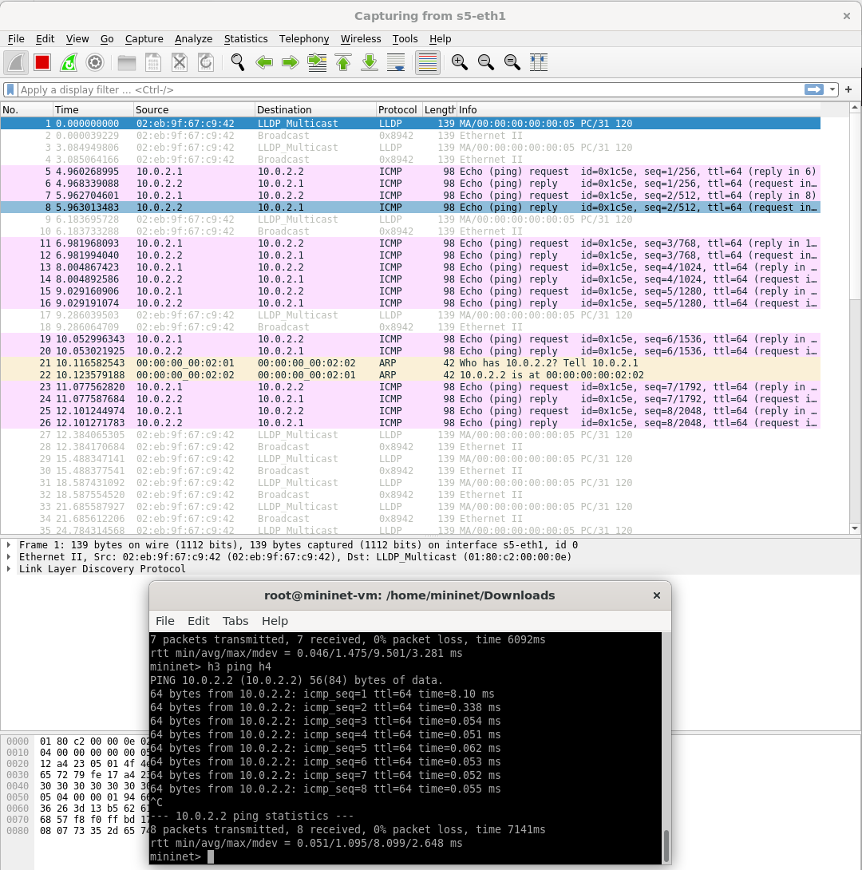
WIRESHARK STATS (h3 ping h4 in Switch 5)

Slide 11
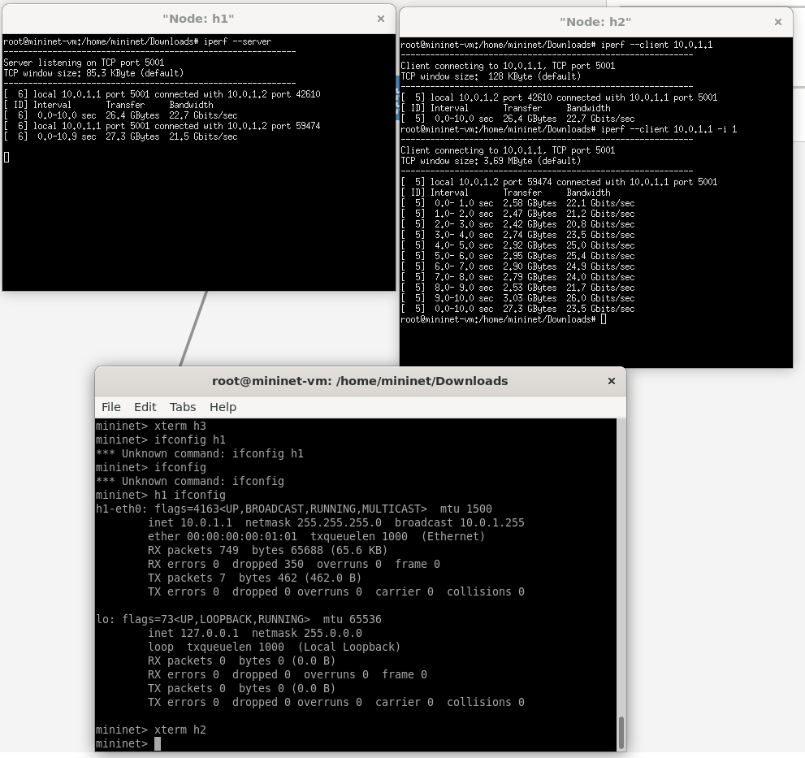
IPERF STATS -> h1 as Server and h2 as Client.

Slide 12
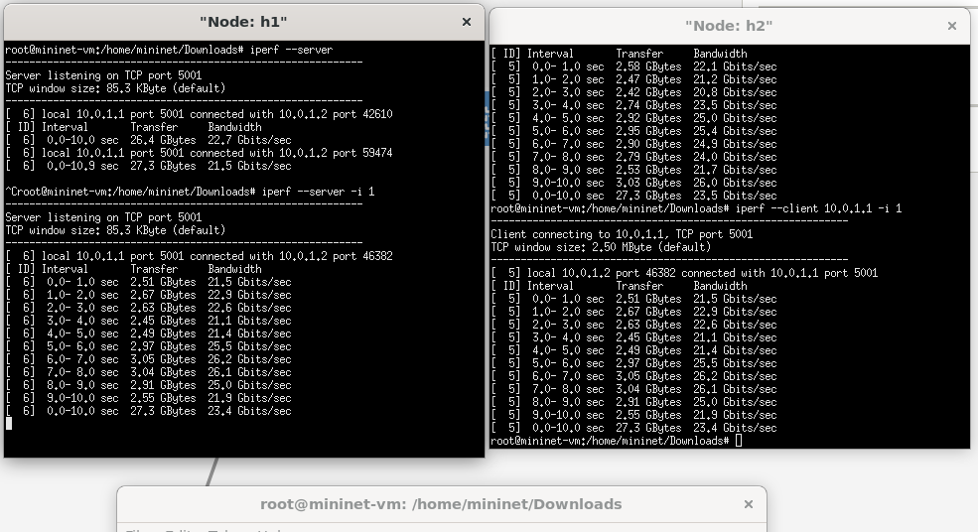
Iperf using cmd (-i 1) -> The client will display bandwidth and performance statistics every 1 second during the test.

Slide 13
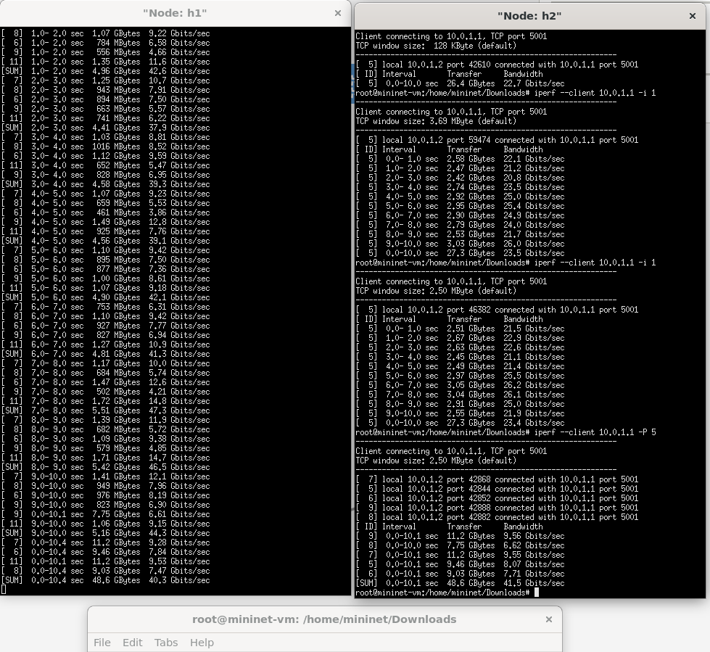
Iperf using cmd (-P 5) -> To generate a given number of sessions.

Slide 14
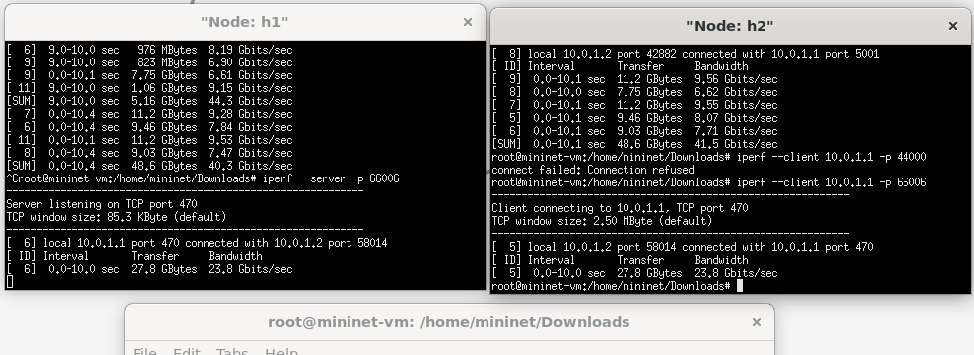
Iperf using cmd for assign port (-p) -> Specifies the port number that the server will listen on for incoming client connections.

Slide 15
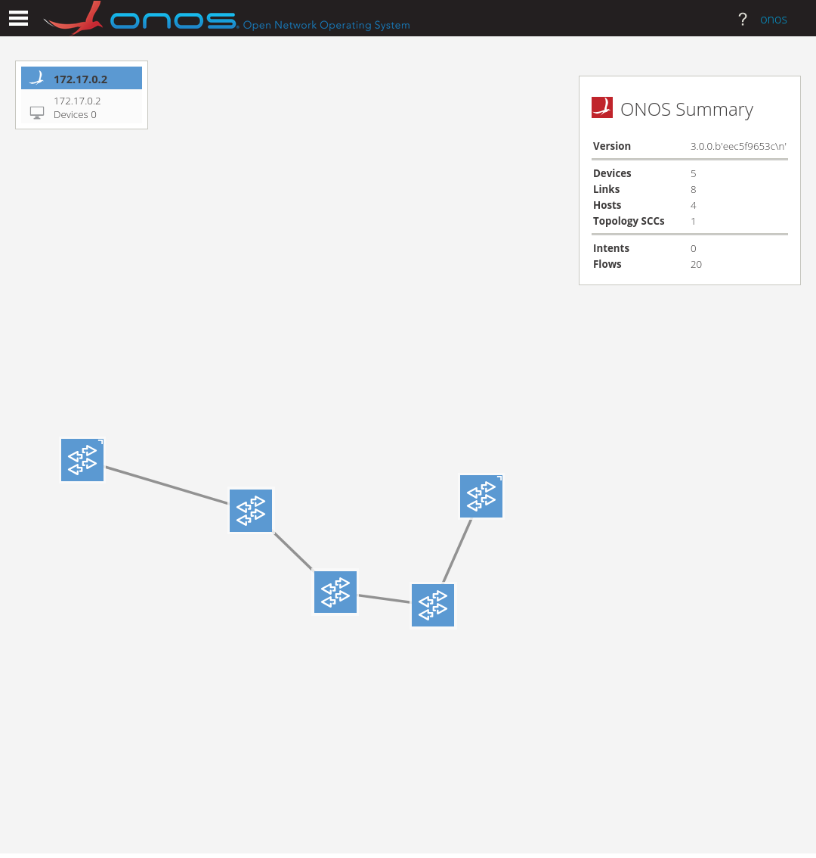
ONOS GUI Result of Topology (5 switches)

Slide 16
Conclusion
This project demonstrates the implementation of a VLAN-based network using Mininet and Open vSwitch. A linear (tail) topology with five switches was created, ensuring VLAN traffic segregation and trunk connectivity across the network. Hosts in the same VLAN successfully communicated, while cross-VLAN traffic remained isolated. This project serves as a practical example of scalable and secure VLAN configurations, ideal for testing and designing real-world network architectures.

Slide 17

Thanks for
Your Attention

